Slide 1
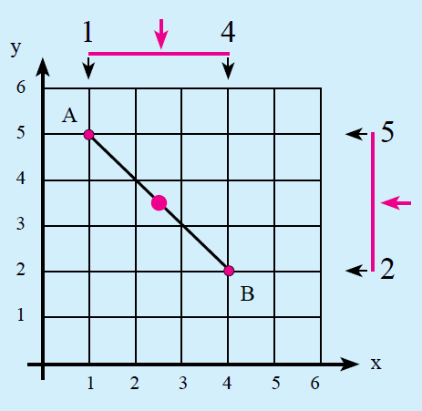
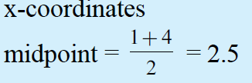
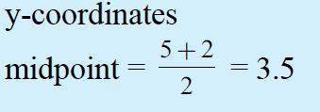

24
7
30
Topic: Midpoint of a Line
Date:
EQ – How do you find the midpoint?
Find the midpoint between A(1,5) and B(4,2)
Step 1: Find the midpoint for the x – coordinates
Step 2: Find the midpoint for the y – coordinates
Step 3: Put the answers in coordinate form

Slide 2
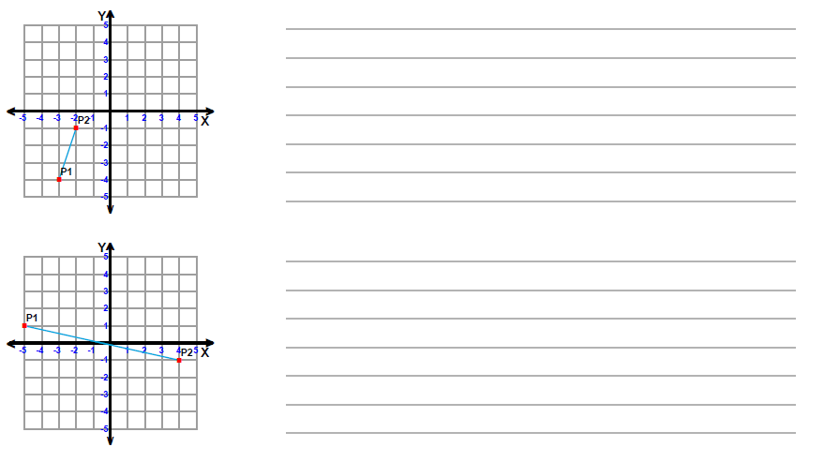

Slide 3
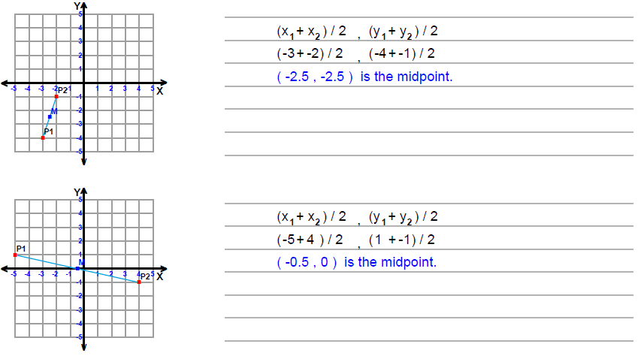

Slide 4
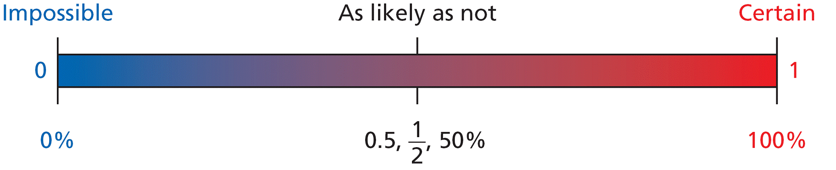
Probability
Probabilities are written as fractions or decimals from 0 to 1, or as percents from 0% to 100%.
A Sample Space is a list of all the possible outcomes.
Eg flipping a coin = {heads, tails}
rolling a dice = {1,2,3,4,5,6}

Slide 5
Probability - Experimental vs.Theoretical
Experimental probability:
P(event) = number of times event occurs
total number of trials
Theoretical probability:
P(E) = number of favorable outcomes____
total number of possible outcomes

Slide 6
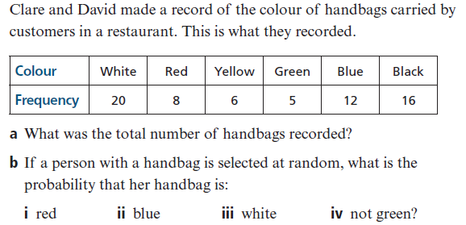
Probability
What is the sample space for year groups at a high school?
A bag of mixed chocolates contains pieces of dark chocolate, milk chocolate, white chocolate and “marbled chocolate. Write the sample space?
3

Slide 7
Probability
What is the sample space for year groups at a high school?
A bag of mixed chocolates contains pieces of dark chocolate, milk chocolate, white chocolate and “marbled chocolate. Write the sample space?
3

Slide 8
Probability
Tree diagram.
Eg. Three coins are thrown together. Use a tree diagram to show the sample space
Second Coin
Third coin
First coin
H
=HHH
H
=HHT
H
T
H
=HTH
T
T
=HTT
H
=THH
H
=THT
T
T
H
=TTH
T
T
=TTT
Q. What is the probability that I will get at least 2 heads?
=4/8
=1/2

Slide 9
A two way table is another way to display the outcomes of a 2 step experiment. We can then use the results to calculate probability.
Example
a dice is thrown and a coin is tossed. Determine the possible outcomes
 | 1 | 2 | 3 | 4 | 5 | 6
Heads | 1, Heads | 2, Heads | 3, Heads | 4, Heads | 5, Heads | 6, Heads
Tails | 1, Tails | 2, Tails | 3, Tails | 4, Tails | 5, Tails | 6, Tails

Slide 10
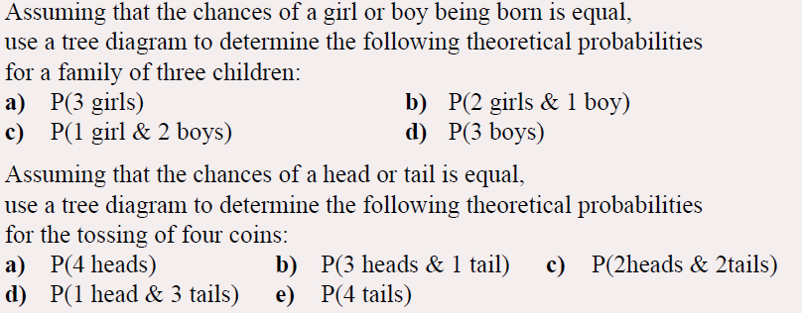
1
2

Slide 11
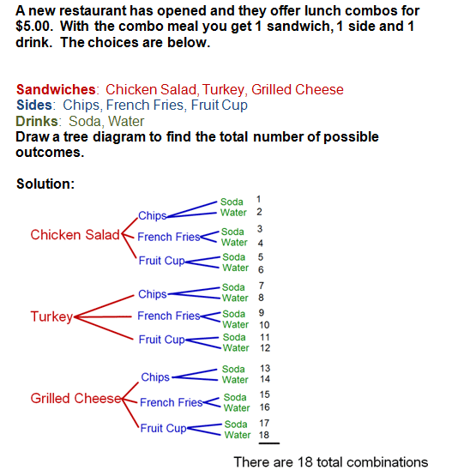

Slide 12
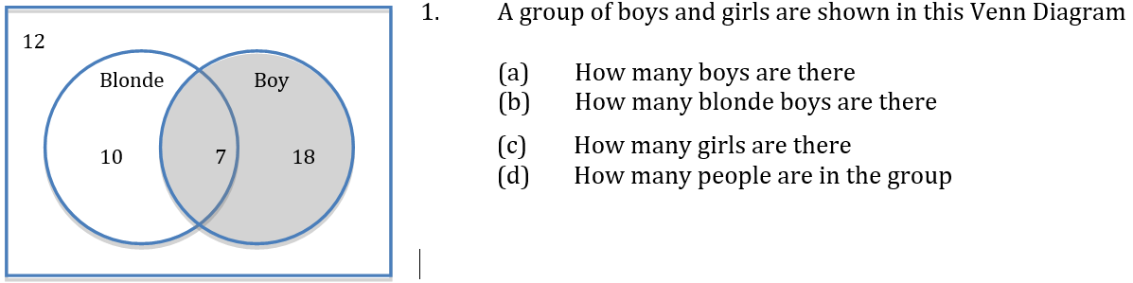
Venn diagrams
Total number of boys is 7 + 18
The total number of people in the group is 12 + 10 + 7 + 18
Total number of blonde boys is 7
Total number of girls is 10 + 12 (blondes who aren’t boys or people who aren’t boys or blonde)

Slide 13
Relative frequency = $\frac{Number of times an outcome occurs}{total number of outcomes}$
House roof | Numbers | Relative Frequency
Tiles | 192 | 192 ÷ 400 = 0.48
Shingles | 4 | 4 ÷ 400 = 0.01
Tin/Steel sheet | 204 | 204 ÷ 400 = 0.51
Total = 400
Expected frequency=probability × number of trials
If there were 1200 homes, how many would have tiled roofs?
1200 x 0.48 = 576

